Slide 1
HSP FY25 Application Training
April 10th, 2024

Slide 2
Content
HSP25 Application Overview
HUD Data Reports
Project Portal Submission Refresher
Questions?

Slide 3
Application Overview

Slide 4
HSP Overview
HSP prioritizes funding for projects that:
● Divert households who are at-risk of becoming homeless through creative problem-solving, safe family/friend reunification and mediation, and homeless prevention
● Rapidly and effectively connect people experiencing homelessness with mainstream benefits, income, and permanent housing opportunities
● Serve especially vulnerable groups, such as unsheltered individuals, unaccompanied youth, domestic violence survivors, and individuals with complex medical and behavioral health needs
● Implement evidence-based practices and demonstrate fidelity to best practice program models
● Deliver services in a safe, inclusive, equitable, and accessible manner
Eligible activities include street outreach, shelter, host homes, rapid re-housing, permanent supportive housing, homeless prevention/diversion, HMIS data entry and system administration, and administrative costs.
Eligible applicants include:
1. A HUD-approved Collaborative Applicant/lead agency of a Maryland Continuum of Care (CoC), OR
2. A DHCD-approved lead agency for a Balance of State CoC Local Homeless Coalition (LHC)

Slide 5
HSP Overview (contin.)
Expectations of Grantees
-Lead agencies may subgrant all or part of their HSP grant to government agencies or nonprofit organizations to provide eligible services.
-Grantees that are awarded HSP funding are required to perform due diligence in regards to organizational capacity of subgrantees before making awards.
-Lead agencies will be required to complete risk assessments to inform selection of subgrantees for financial and programmatic monitoring and ensure that programs ar operating within the requirements and regulations of the program.

Slide 6
Expected Funding Availability for State Fiscal Year 2025
Name | Sources | Amount
Emergency Solutions Grant (FFY2024) | Federal- HUD | $1,202,580
State HSP Funds (SFY 2025) | Maryland | $14,439,261
Total Available Funds |  | $15,641,841
DHCD anticipates overall level funding for HSP in FY25. A minimum of $1 million will be allocated specifically for projects dedicated to serving unaccompanied youth.
SFY2025 HSP grant agreements will have an 18-month performance period – July 1, 2024 through December 31, 2025.
HSP applicants may submit a total funding request up to 125% of their FY24 HSP award amount. Both new and renewal projects will be considered for funding. DHCD will competitively evaluate both the CoC’s overall application and individual project performance. Individual projects may be awarded funds at their full request or a reduced amount, or DHCD may decline to fund a specific project. Depending on the quality of the projects submitted, CoCs may receive an overall higher or lower award compared to FY24.

Slide 7
FY 25 Application and Program Changes
HSP has consolidated funding sources internally and will no longer have minimums and maximums for case management, rental assistance, and shelter. This will maximize flexibility and braiding of HSP with other CoC/LHC funding sources.
Project-based leasing, operating, and rental assistance costs are now allowable line items for permanent supportive housing projects. Tenant-based rental assistance for PSH is not eligible due to potential annual changes in state appropriations for HSP.
Direct cash transfer programs for highly vulnerable households are now eligible:
1. Unaccompanied youth
2. Returning citizens from incarceration
3. Pregnant or parents/caregivers/guardians with children under 5
4. Other subpopulations with high rental housing barriers

Slide 8
Changes (contin.)
Flex funds for landlord incentives, removal of tenant housing barriers, and other essential costs are now eligible under this flexible expense line item. These funds are intended to mitigate unique barriers in progress towards housing stability consistent with client-centered best practices. For example, individuals matched to a Housing Choice Voucher may have debt owed to the Public Housing Authority which will prevent them from being approved until resolved – a flex fund can provide flexible assistance to remove the barrier.
CoC/LHCs must continue to provide a 25% match for the HSP Grant. However, documentation of match is no longer required for the HSP application – compliance with match requirements will be evaluated through program monitoring.

Slide 9
Application Review Process
All applications will be subject to three reviews:
1. Threshold Review
2. CoC/LHC Performance Evaluation
3. Project-Level Performance Evaluation
The threshold review determines if the application is complete and contains all required attachments. Once an application passes the threshold review, it is competitively scored by DHCD staff based on the overall CoC/LHC application responses, proposed activities and the annual performance data submitted for each renewal project.
Notes:
DM to cover

Slide 10
Eligible Activities and Costs
HSP provides funding for eight main activities:
1) Homeless Prevention/Shelter Diversion- programs that assist households to remain in their permanent housing or relocate to other permanent housing when they are considered at-risk of becoming homeless. Eligible costs include rental assistance, financial assistance, and housing stabilization services.
2) Emergency Shelter- activities that connect people with immediate access to overnight shelter in order to respond to a crisis. Funding provided for Emergency Shelter can be used both to pay for the operations of the shelter, such as rent and utilities, as well as services provided by the shelter, including case management. * Any shelter that accepts children is considered a “Family” shelter.
3) Street Outreach- services that are provided to currently unsheltered individuals and families, including engagement and case management.
4) Rapid Re-Housing- assists homeless households who are unsheltered or staying in emergency shelter or motel with obtaining permanent housing in a regular rental unit in the community. Eligible costs include rental assistance, financial assistance, and housing stabilization services. Note: RRH programs targeted to unaccompanied homeless youth may also serve households or clients meeting HUD categories 2 or 3 in their programs.
Notes:
DM to cover

Slide 11
Eligible Cost (contin.)
5) Permanent Supportive Housing- provides households with non-time limited subsidized permanent housing and supportive services. Eligible costs include case management services such as linking residents to supportive services, as well as staff costs for those who assist clients in applying for food, medical, and other benefits. Additional eligible costs include project-based leasing, operating, and rental assistance costs.
6) Homeless Management Information System (HMIS)- covers the costs of data collection through an HMIS database. All providers must enter data into HMIS or, for victim services providers, a comparable database.
7) Special Events- covers the Homeless Resource Day events that are intended to connect people with available services, as well as activities designed to support the annual Point-in-Time (PIT) count.
8) Administration Support Cost. Administration Support Costs include funding used for staffing COC/LHC and Coordinated Entry personnel, Training and Technical Assistance, as well as conference and meeting costs. Funding in this category also supports initiatives to encourage development of Youth Action Boards and Lived Experience Committees.
A full list and description of eligible activities, costs, and policies is available in the HSP Grantee Policy Guide.
Notes:
DM to cover

Slide 12
Application Checklist
□ Update Organizational Profile Contact Information and Attachments:
□ W-9 with address and EIN that matches your state vendor registration (both governments and nonprofits)
□ Agency Organizational Chart (both governments and nonprofits)
□ Most Recent Single Audit or Independent Financial Audit (both governments and nonprofits)
□ Articles of Incorporation and Bylaws (nonprofits only)
□ Federal Tax Exemption Determination Letter (nonprofits only)
□ Certificate of Good Standing from Maryland Department of Assessments and Taxation (nonprofits only)
□ Copy of Charity Registration Status from Maryland Secretary of State website (nonprofits only)
□ List of Board of Directors (nonprofits only)
□ Create a FY2025 Community Development and Services Application for HSP in the Project Portal
Notes:
Make sure your org profile is updated.

Slide 13
Application Checklist (contin.)
□ Complete DHCD Project Portal Application and Budget Screens Note: The portal budget screen should include only one “activity”: Operating
□ Upload supporting attachments to your application in the portal:
□ CoC/LHC Application – Word
□ Detailed Budget and Project Listing - Excel
□ Stella P Report (see application template for more instructions)
□ 2023 System Performance Measures Report (see application template for more instructions)
□ HUD Annual Performance Report (APR) from HMIS for each renewal project
(Performance Period: 1/1/2023-12/31/2023)
□ 2024 Housing Inventory Count and Point in Time Count (not scored – DHCD will send instructions for how to export these reports from HDX 2.0 at a later date closer to the grant application deadline)

Slide 14
Application Components
8 Part Narrative Application (Word Document)
Part 1: Strategy
Part 2: Project Selection
Part 3: System Performance
Part 4:Coordinated Entry
Part 5:Equity
Part 6: Compliance and Quality
Part 7: Youth Projects
Part 8: RRH and PSH Projects
Detailed Budget Template (Excel spreadsheet)
Program Budget Request Tab
Total Projected Served Tab

Slide 15
Applicant Information- Complete in Entirety

Slide 16
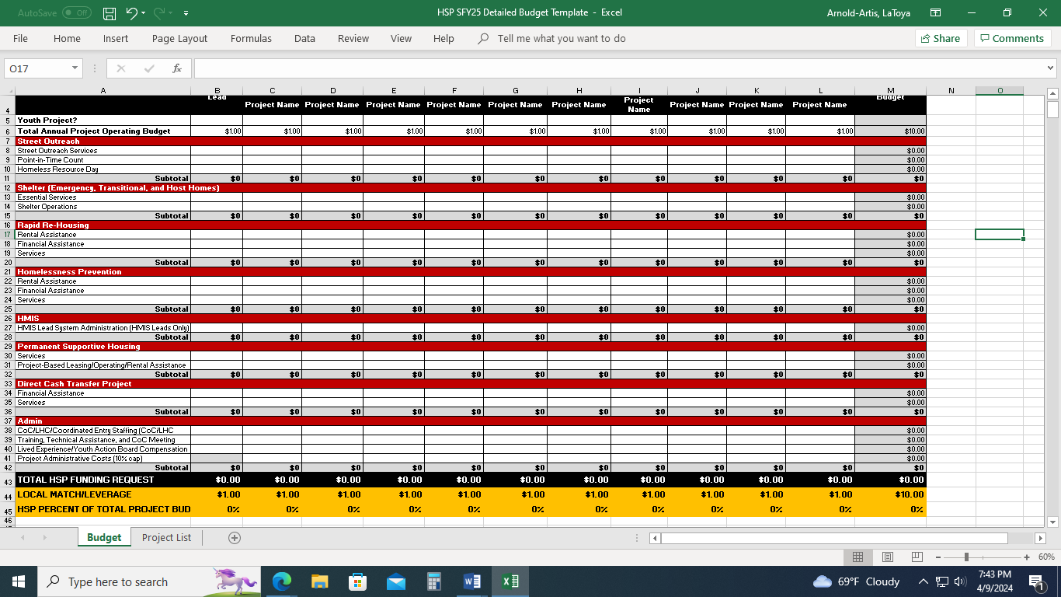
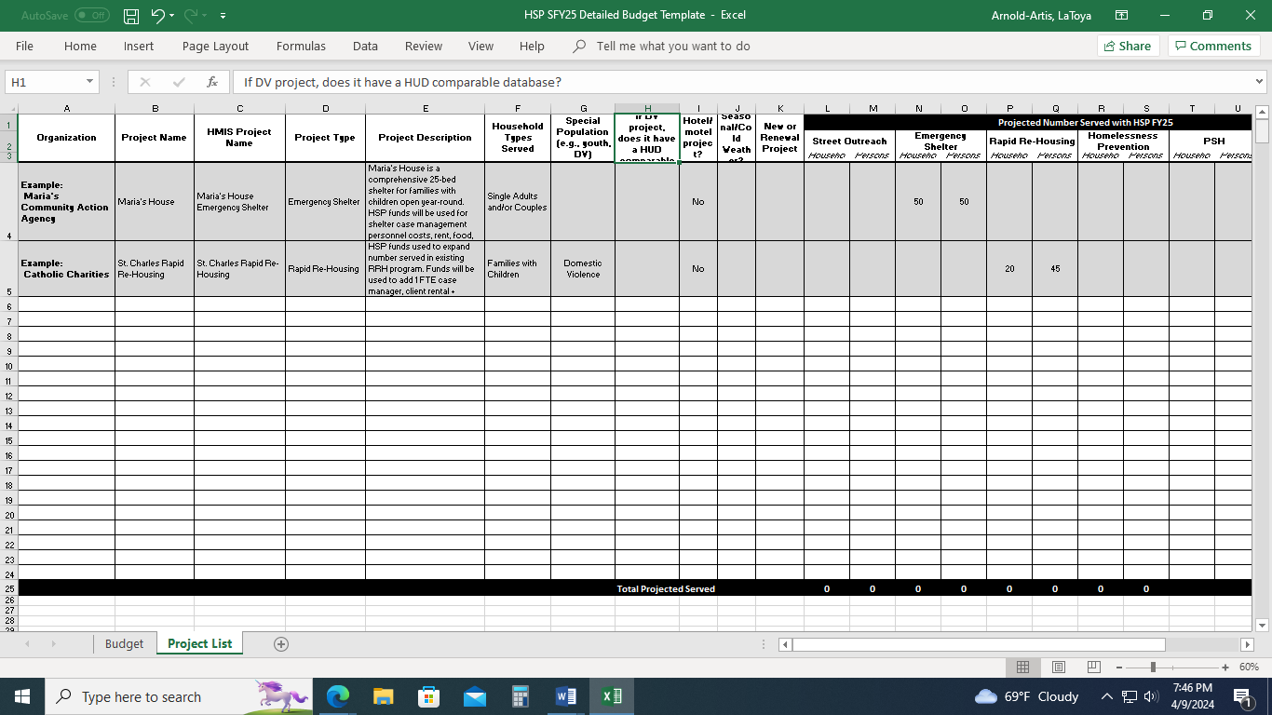
Detailed Budget Template
INSTRUCTIONS: ☗Enter the funding request for each individual project included in your CoC/LHC application. In the column header, replace "Organization" and "Project Name"with the name of the organization and project. Note whether a project primarily serves unaccompanied homeless youth. ☗ Enter the total project budget (all funding sources) for each project. Do not replace the formulas in any of the subtotal/total cells or the match/percent of project budget rows. ☗ Only enter data and numbers into white cells. If your CoC/LHC has more than 10 projects, create a second copy of the budget template.

Slide 17
HUD Data Reports

Slide 18
Project Portal Submission Refresher

Slide 19
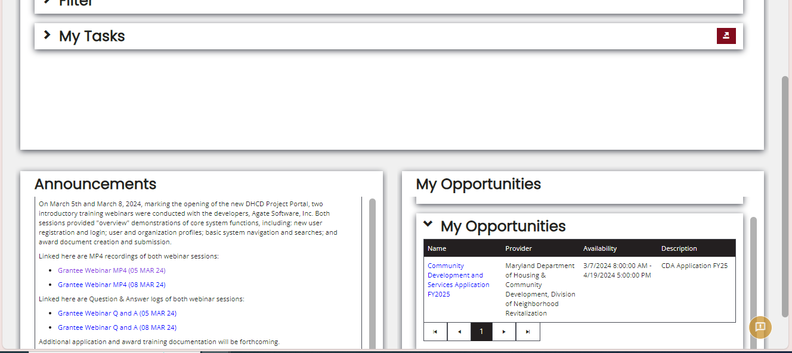
The HSP 25 application should now be visible on your Project Portal Dashboard under “My Opportunities”. The posted due date is incorrect and will be updated soon. The application is due May 8th, 2024 at 5pm. If you do not see the application posted, please let me know.

Slide 20
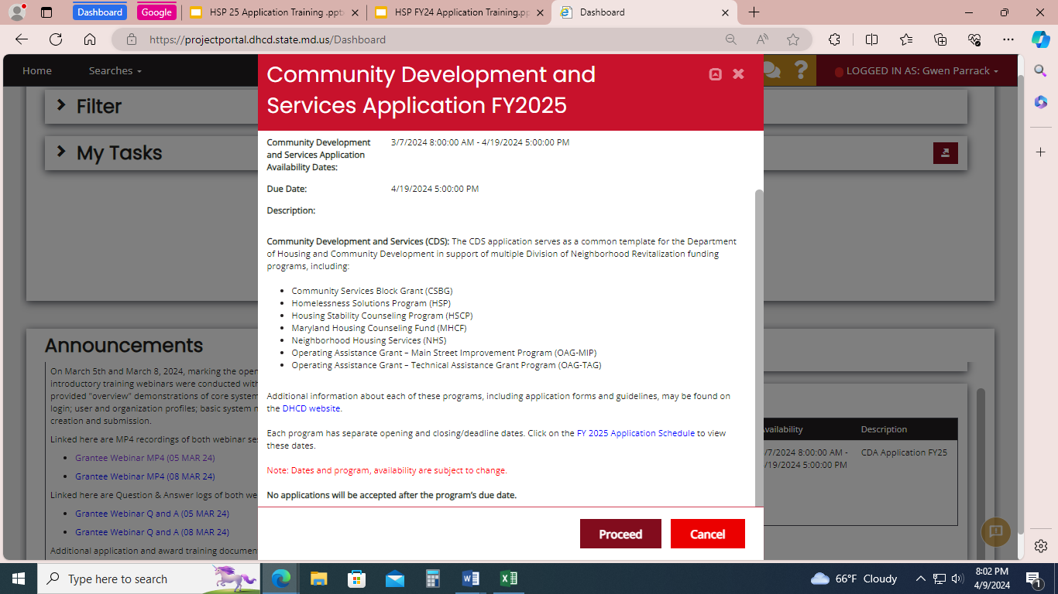
Click “Proceed” to initiate the application.

Slide 21
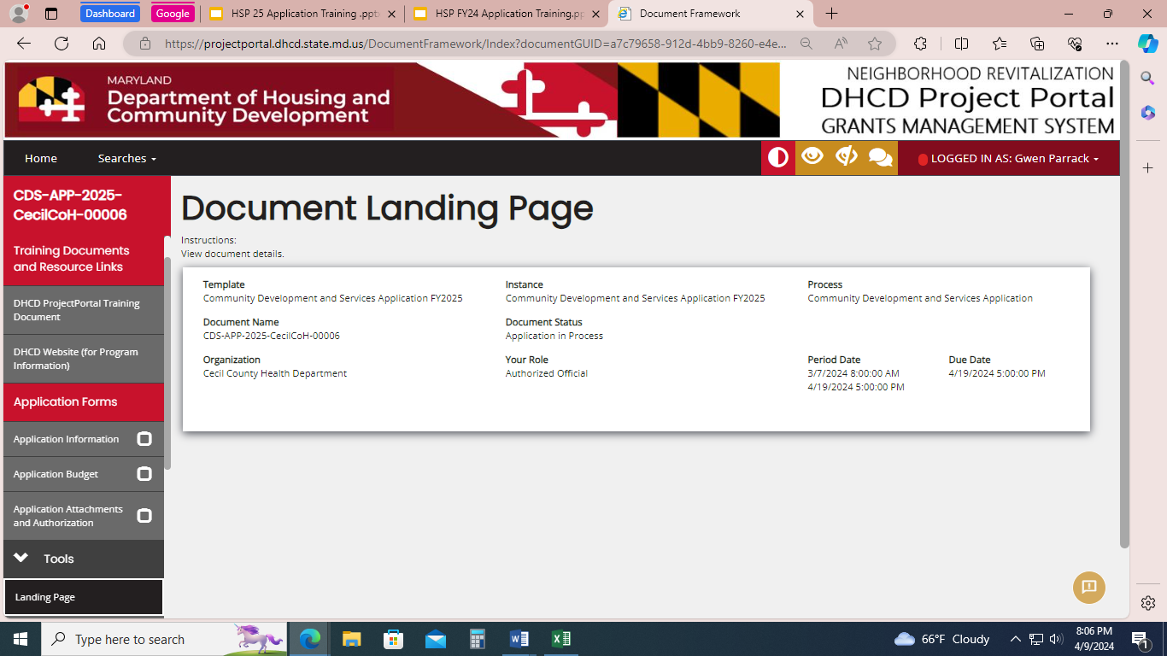
Begin the application from the first bullet under Application Forms. Select “Application Information”.

Slide 22
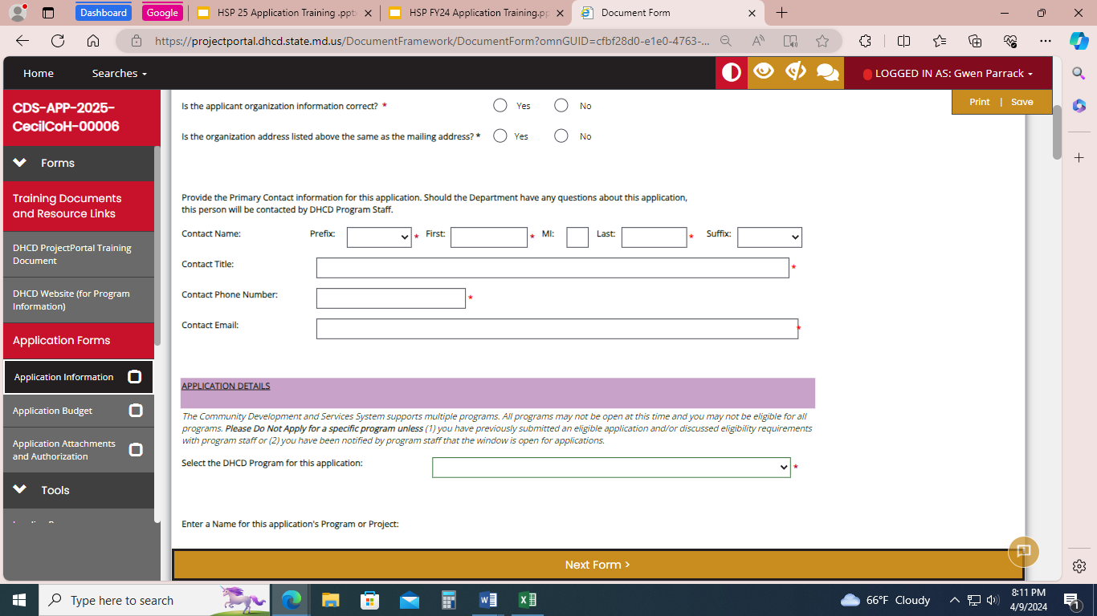
Complete the Application Information page. Be sure to complete/ update any missing information in the Organization information section.

Slide 23
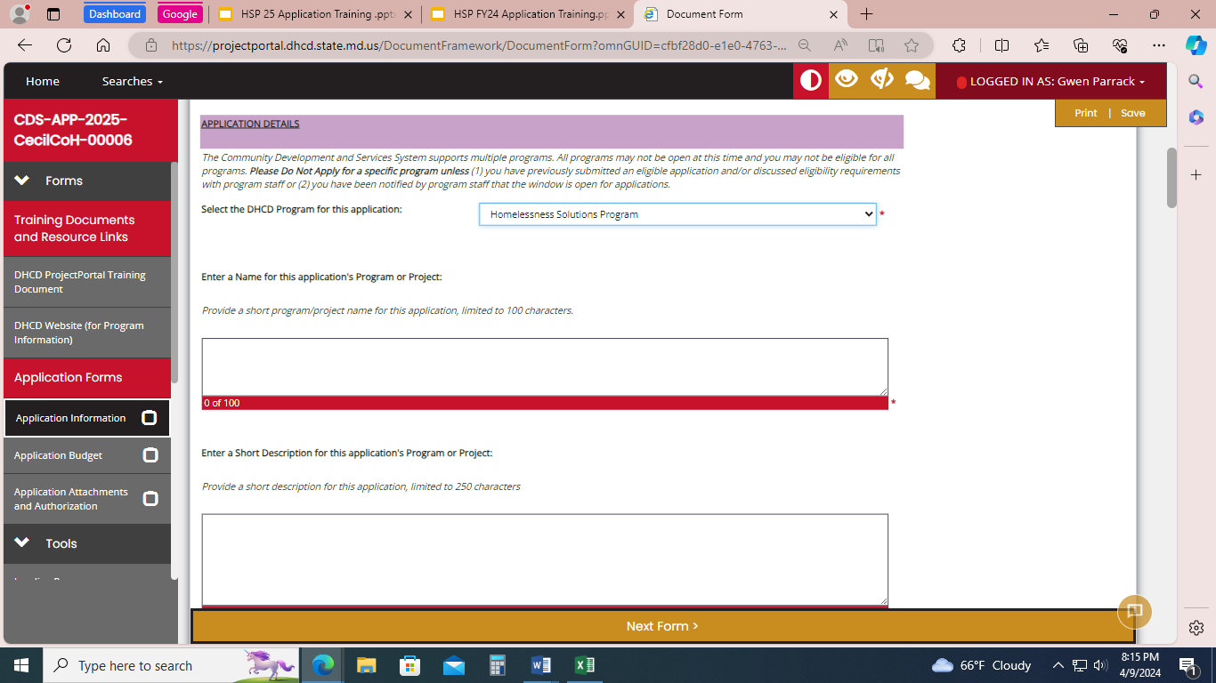
UNDER APPLICATION DETAILS:
For the DHCD Program.. select Homelessness Solutions Program.
For the Program Name use:
{Agency Name} HSP SFY25 Program Application
For the short description use:
“{Agency Name} is applying for Homelessness Solutions Program funding, which will provide services and housing to prevent and end homelessness for Maryland residents.”

Slide 24
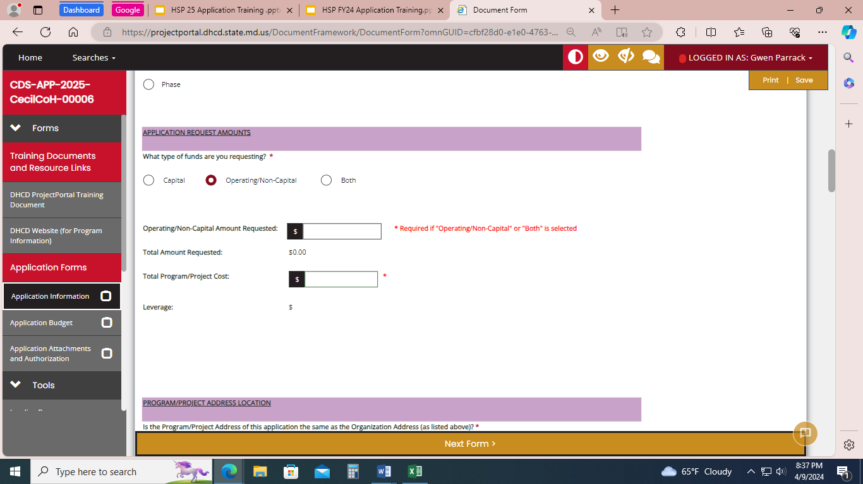
The funding type is “Operating/ Non- Capital.
Enter the Total Requested
Enter Total Project Cost
Notes:
Total Requested is located at the bottom of the budget spreadsheet. Total Project Cost is located at the top of the spreadsheet. Leverage will auto-calculate.

Slide 25
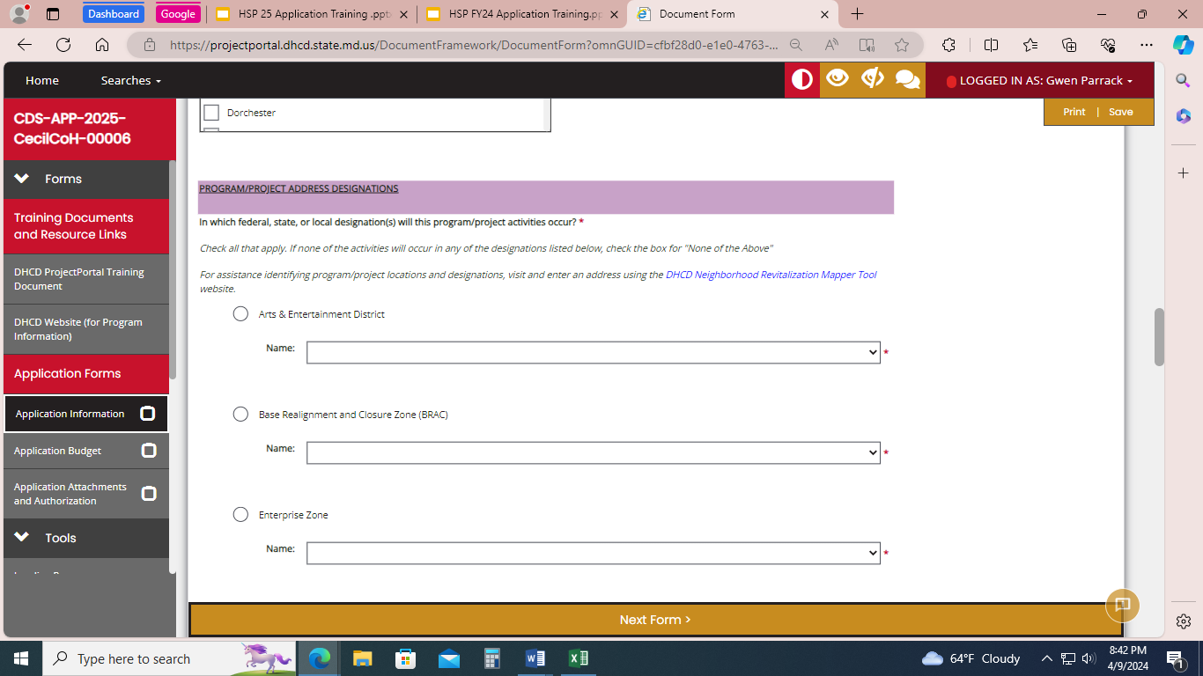
For Program/ Project Address Designation:
Scroll to the bottom of this section and select, “None of the Above”

Slide 26
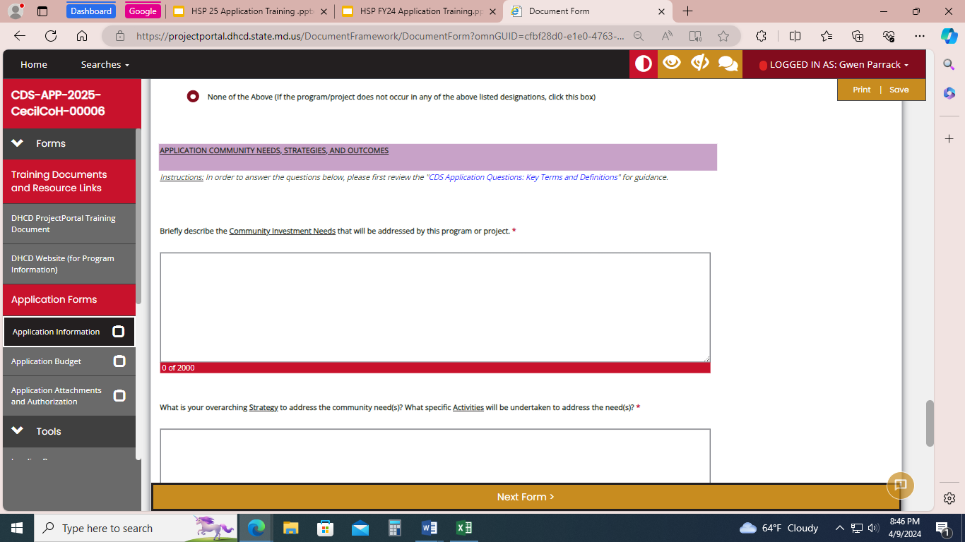
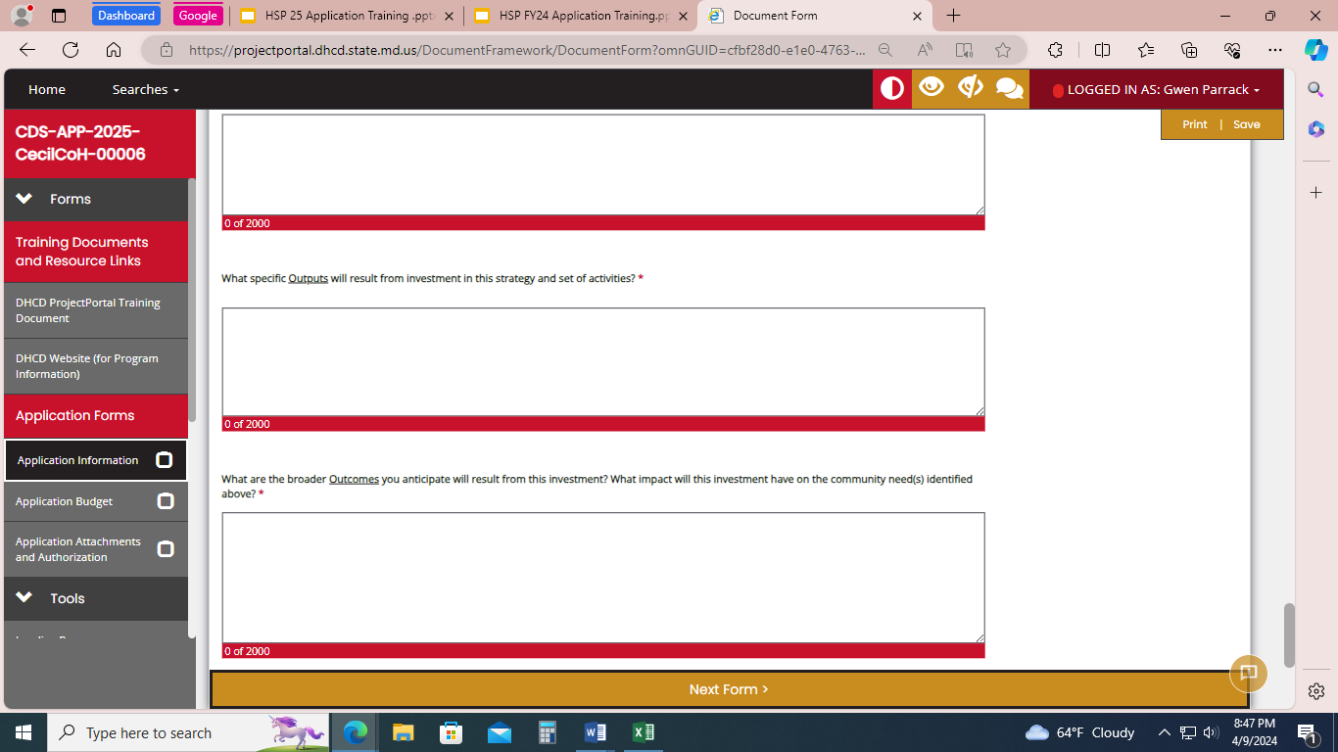
Application Community Needs, Strategies and Outcomes: This questions will be addressed in the narrative of the application. Please just enter, “See Attached” in these fields.

Slide 27
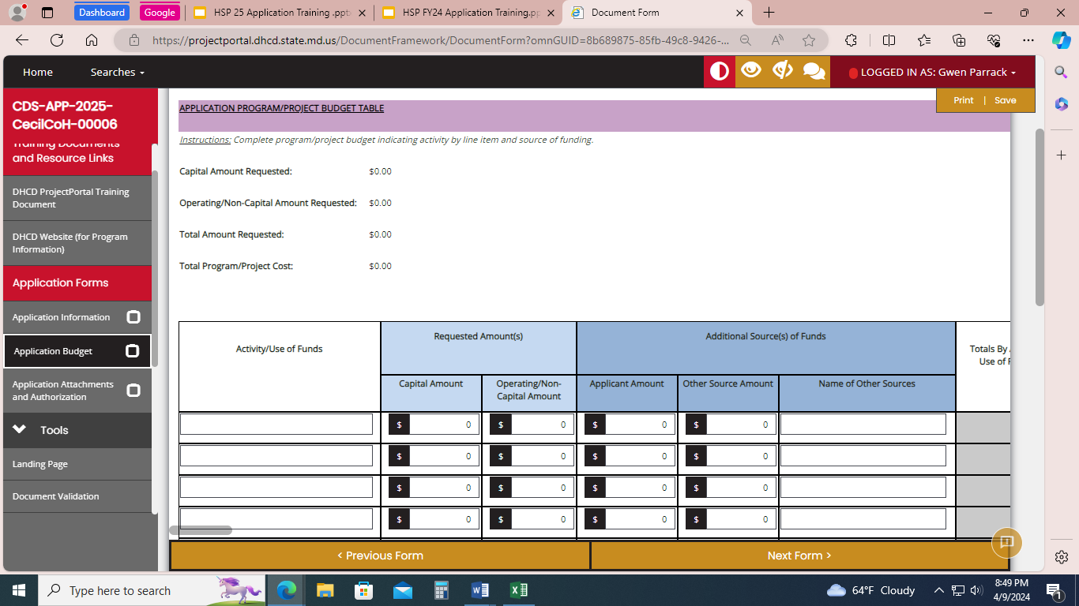
Application Budget:
Create ONE activity/use of funds called “operating”. Enter the total amount of your CoC/LHC request into the “operating/non-capital amount” box in the activity line. *Do not enter project types or any other activities.

Slide 28
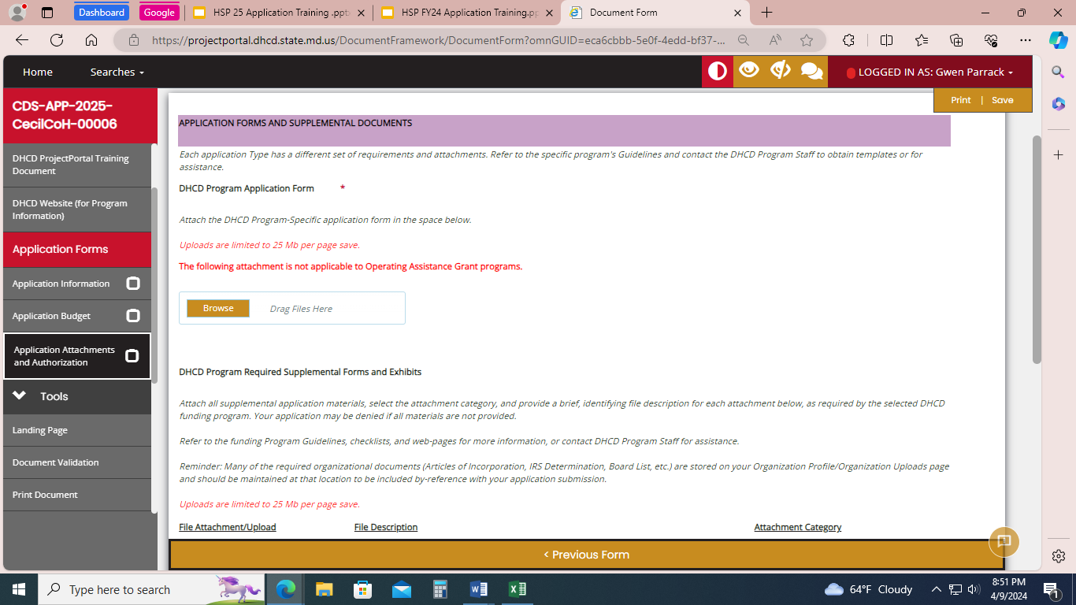
Application attachments: For DHCD Program Application Form attach the HSP Application Narrative

Slide 29
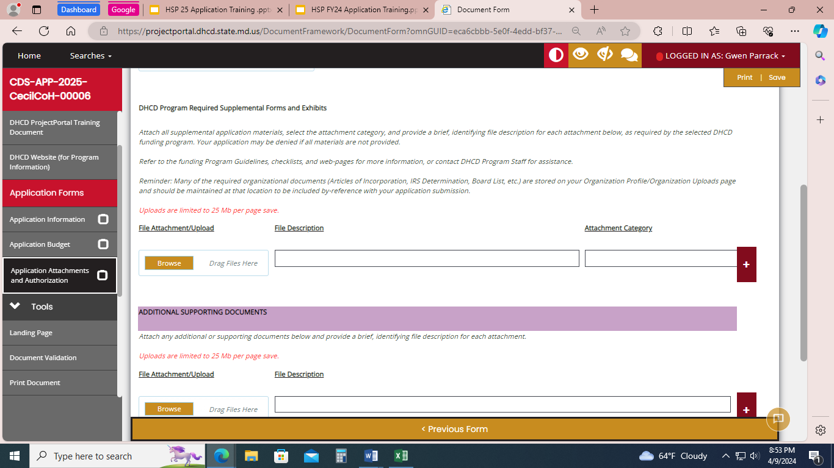
Required Supplemental Forms:
Budget Template
System Performance Measures Report
Stella P Report
HIC and PIT Files (instructions forthcoming)
HUD APR from HMIS for each renewal project

Slide 30
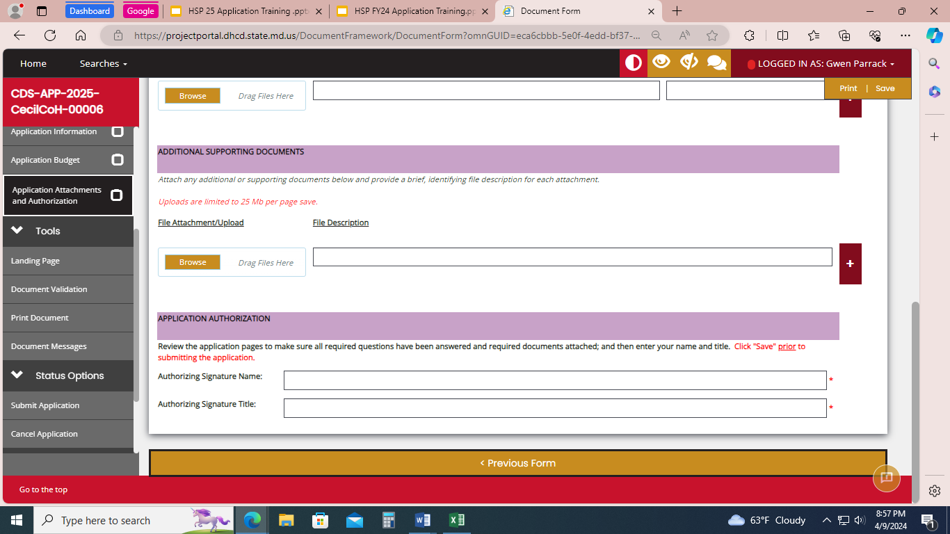
Submitting the application:
1. SIGN the form
2. Click SAVE (at the top right corner of the page) *if you skip this step, the information you entered will not be saved.
3. Under Status Options on the left panel (you may need to scroll down)…select “Submit Application”

Slide 31
Questions?

